Slide 1

Pipelined Architecture of RISC-V Processor with Hazard Control
Bijaya Nanda Murmu (B220020)
Pratik Ray (B220039)
Siddharth Sahu (B220054)
under the guidance of
Dr. Pradyut Kumar Biswal
Department of Electronics & Telecommunications
International Institute of Information Technology Bhubaneswar
Bhubaneswar, Odisha, 751003, India
May, 2024

Slide 2
Objective
Motivation
The motivation behind RISC-V RV32I, the 32-bit integer base instruction set variant of the RISC-V architecture, lies in addressing the need for a standardized, open-source, and flexible instruction set architecture that caters to diverse computing requirements while promoting innovation and collaboration in the field of computer architecture.
Implement a High-Performance RISC-V Core: Design and implement a 5-stage pipelined RISC-V RV32I processor core for efficient execution of integer instructions.
Achieve Full Hazard Control: Integrate techniques like forwarding and stalling to ensure smooth instruction flow within the pipeline and avoid incorrect results.
Leverage Open-Source Advantages: Utilize the open-source nature of RISC-V to customize the core for optimal performance within an embedded system application.
Demonstrate Scalability: Highlight the modularity of RISC-V, allowing for future expansion with optional extensions based on evolving project needs.
Showcase Industry Relevance: Emphasize the growing adoption of RISC-V by major companies and research institutions, demonstrating its practicality and potential impact.

Slide 3
Methodology
1) Design and Architecture Exploration:
Study the RISC-V RV32I ISA specifications and understand the instruction set architecture.
Research existing 5-stage pipelined processor designs and explore different pipelining techniques.
`Design the data path and control path for the 5-stage pipeline, considering data hazards and control hazards.
2) Hazard Control Implementation:
Implement forwarding techniques (data forwarding, control forwarding) to bypass pipeline stages and resolve data hazards.
Implement stalling mechanisms to prevent incorrect results due to control hazards (branch prediction can be explored as an optimization).
3) Verification and Testing:
Develop a comprehensive test suite covering various RISC-V instructions and functionalities.
Utilize simulation tools to test the designed core and verify its functionality under different scenarios.
Implement unit tests for individual pipeline stages to ensure proper operation.

Slide 4
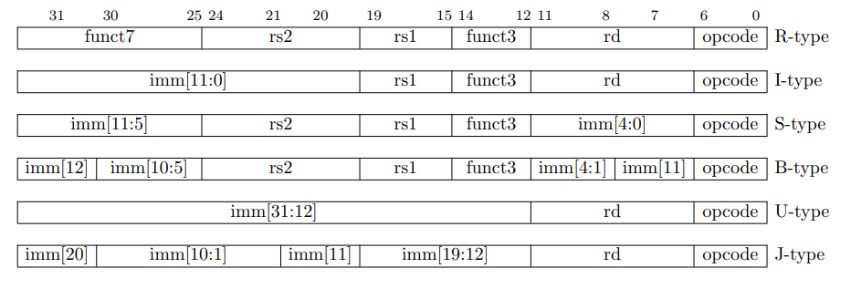
Instruction Format
RISC-V defines six main instruction formats to balance regularity and simplicity in decoder hardware: R-type, I-type, S-type, B-type, U-type and J-type.
Figure 1: RISC-V base instruction formats.

Slide 5
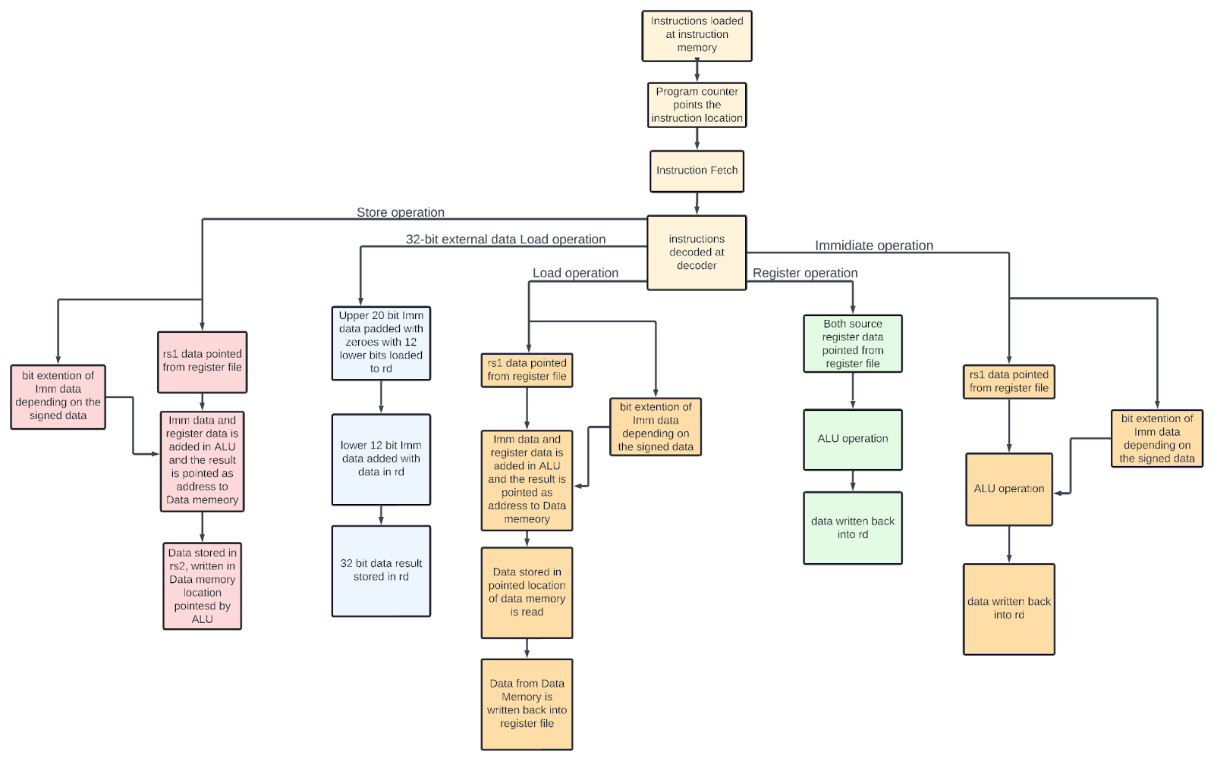
Flowchart
Figure 2: Flowchart for R-type, I-type, S-type and U-type instructions.

Slide 6
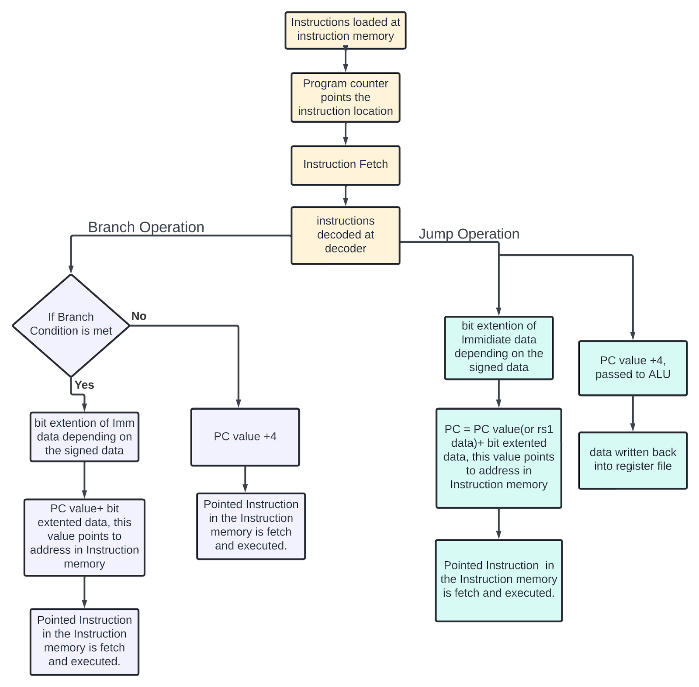
Flowchart
Figure 3: Flowchart for B-type and J-type

Slide 7
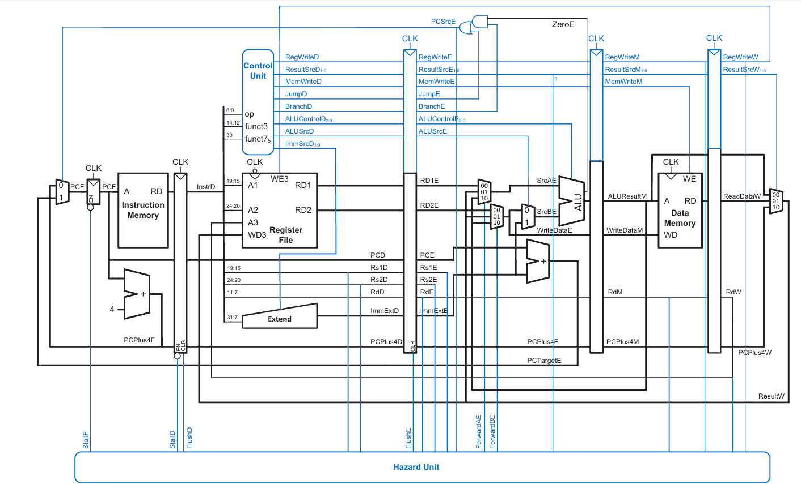
Block Diagram
Figure 4: Block diagram for pipelined architecture RV32I with full hazard control [8]

Slide 8
Implementation Specifications
Program Counter
Register File
Instruction Fetch
Fetch Decode Pipeline Stage
Instruction Decoder
Decode Execute Pipeline
ALU
Execute Memory Pipeline Stage
Data Memory (Memory Access)
Memory Writeback
Stall controller
D-cache & I-cache
No. of registers in Register bank | 32
Size of each register | 32bits
Register Bank Size | 128 Bytes
Instruction memory size | Upto 4 GB
Data memory size | Upto 4 GB
Clock Frequency | 50MHz
Bus size (address bus and data bus ) | 32-bit
Pipeline Stages | 5
RISC-V Base Integer set | RV32I

Slide 9
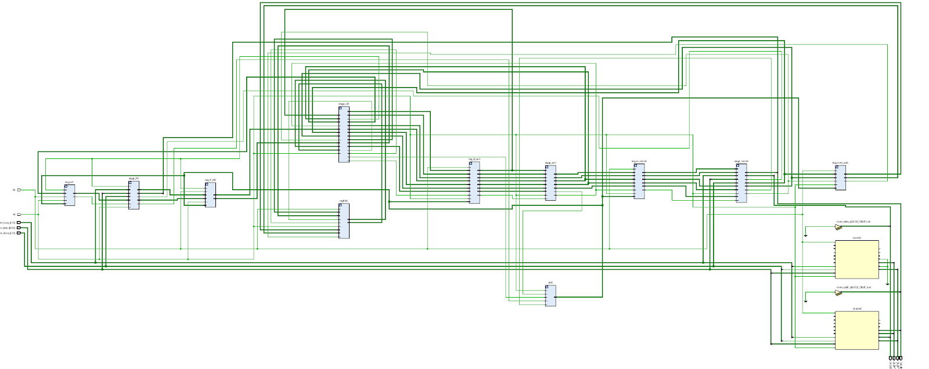
Architecture (Schematic)
Decoder
IF → ID Pipeline
ID→EX Pipeline
EX→MEM Pipeline
Memory WB
PC
Instruction
Fetch
ALU
Data Memory
I-Cache
Reg File
Stall Unit
(Hazard Control)
D-Cache
Figure 5: Schematic output for pipelined architecture RV32I with full hazard control

Slide 10
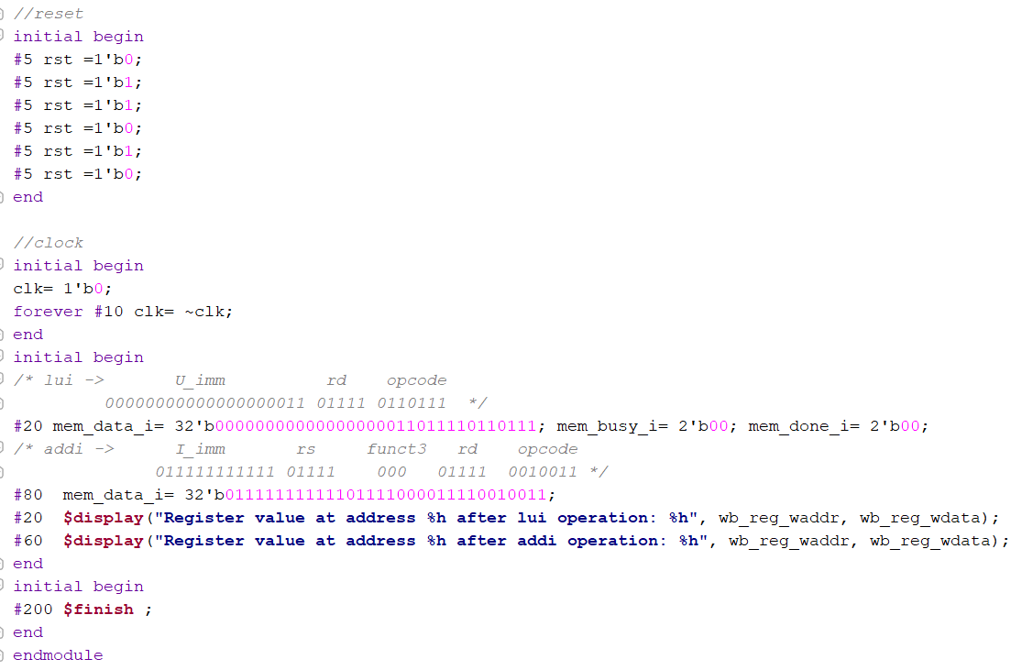


Slide 11
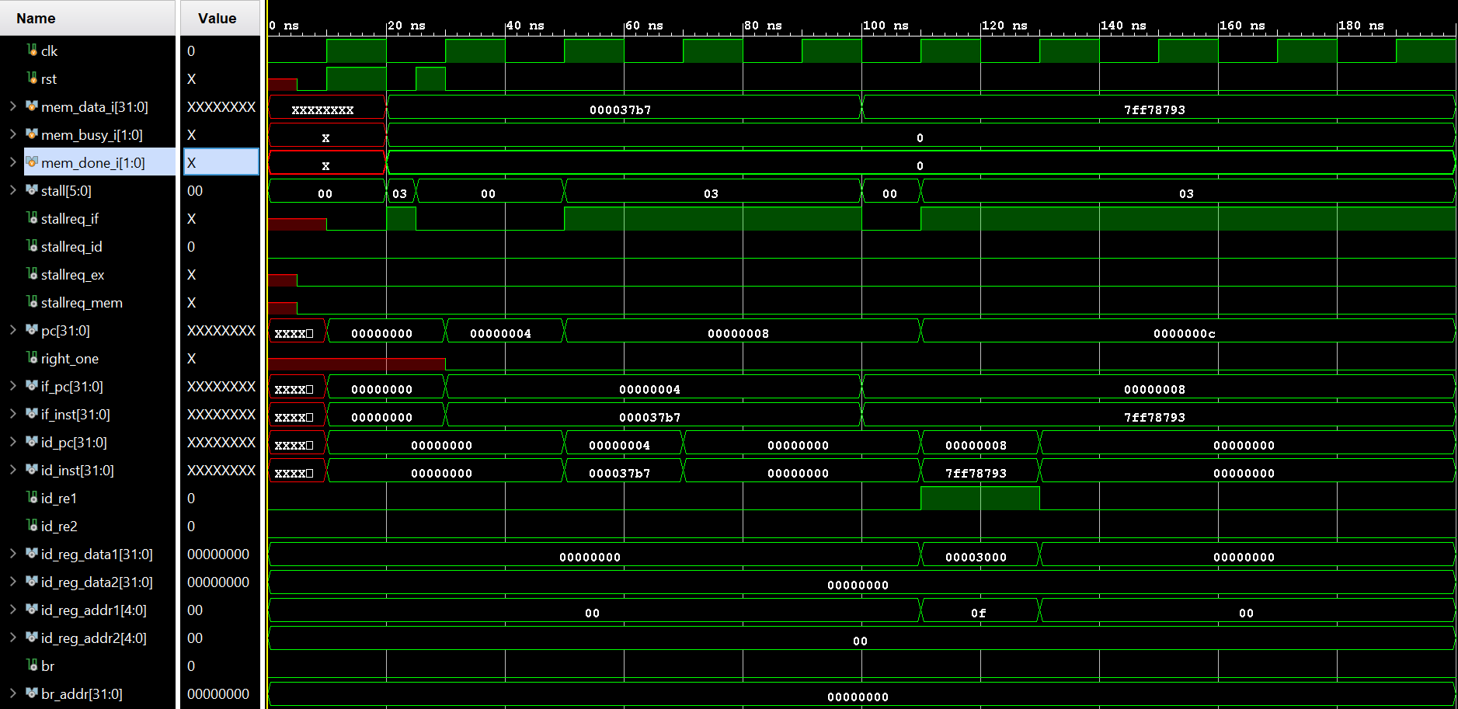
Simulated Waveform

Slide 12
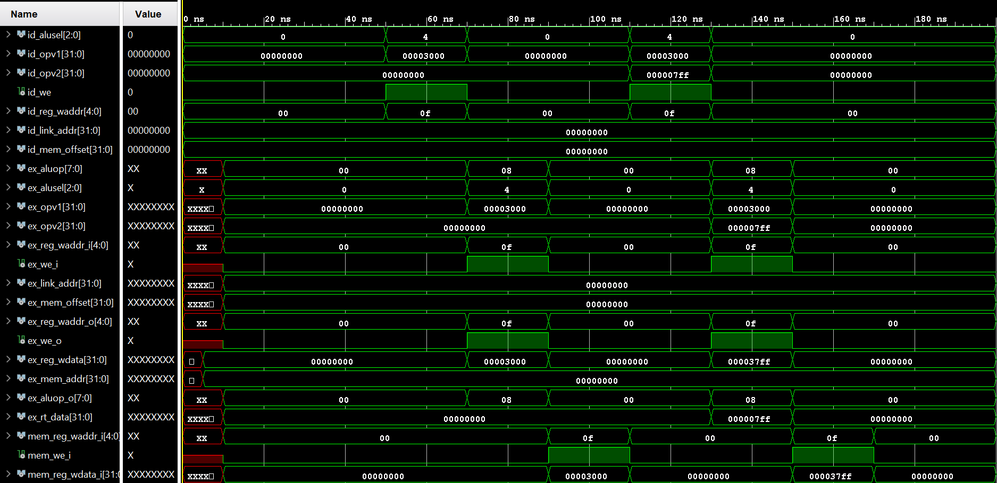
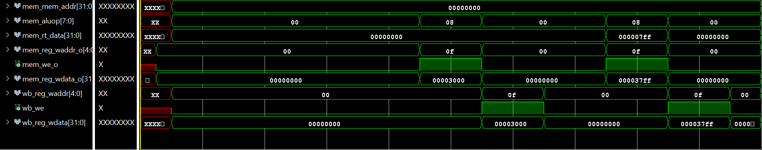

Slide 13
Result
Lui (110-130ns) | Addi(170-190ns)
20bit data after padding = 0003000 | Lower 12 bit = 7FF Addition Result = 00003000 + 000007FF= 000037FF
Address(5-bit) = 0 F (R15) | Address(5-bit) = 0 F (R15)
Figure 6: Register State after lui and addi operation

Slide 14


Conclusion:
Validation:
 | lui operation |  | addi operation
 | Expected result | Actual Result | Expected Result | Actual Result
Destination Register address | 0 1111 |  | 0 1111
Data stored in destination address | 0000 0000 0000 0000 0011 0000 0000 0000 |  | 0000 0000 0000 0000 0011 0111 1111 1111
Our Xilinx Verilog simulation and testbench have definitively demonstrated the successful loading of 32-bit immediate data into a designated register using lui and addi instructions. This achievement conclusively validates the functionality of these core RISC-V instructions within the processor.
Furthermore, the meticulously designed testbench extends beyond this singular test. It comprehensively verifies the processor's ability to handle the extensive instruction set provided by the RISC-V ISA. This comprehensive testing approach definitively confirms the processor's capacity to execute a broad spectrum of RISC-V programs.

Slide 15
References
[1] Kovačević N., Mišeljić, Đ., & Stojković A. (2022). “RISC-V vector processor for acceleration of machine learning algorithms”. In 2022 30th Telecommunications Forum (TELFOR) (pp. 1-6).
[2] An, Hyogeun, et al. "Single Cycle 32-bit RISC-V ISA Implementation and Verification."
[3] TOZLU, Y. S., & YILMAZ, Y. (2021). “DESIGN AND IMPLEMENTATION OF A 32-BIT RISC-V CORE”.
[4] Raveendran, A., Patil, V. B., Selvakumar, D., & Desalphine, V. (2016, January). “A RISC-V instruction set processor-micro-architecture design and analysis.” In 2016 International Conference on VLSI Systems, Architectures, Technology and Applications (VLSI-SATA) (pp. 1-7). IEEE.
[5] Katke, Sharda P., and G. P. Jain. "Design and implementation of 5 stages pipelined architecture in 32 bit risc processor." International Journal of Emerging Technology and Advanced Engineering 2.4 (2012): 340-346.
[6] Dörflinger, Alexander, et al. "A comparative survey of open-source application-class RISC-V processor implementations." Proceedings of the 18th ACM international conference on computing frontiers. 2021.
[7] Samanth, Rashmi, Ashwini Amin, and Subramanya G. Nayak. "Design and Implementation of 32-bit Functional
Unit for RISC architecture applications." 2020 5th International Conference on Devices, Circuits and Systems (ICDCS). IEEE, 2020.
[8]. D. Harris and S. L. Harris, "Digital Design and Computer Architecture, RISC-V Edition," Elsevier, 2021, ch. 7, p. 453.

